Slide 1
Summarization
ANLP
6 December 2018
Tan Yi Chern

Slide 2
This slide will be removed in the final version
Presentation Outline
Definition
Categories
Sentence compression
Single document summarization
Multi document summarization
Query based summarization
Extractive / abstractive
Metrics
ROUGE (1, 2, L, N)
METEOR
Limitations of metrics
Classical Methods and Fundamentals
MMR
Graph based: TextRank and LexRank
ILP
Submodularity
Single Document Summarization: Extractive
Sequence classification problem: scoring and selecting
Joint scoring and selecting
Reinforcement learning against metric as objective function
Single Document Summarization: Abstractive
Seq2seq + attention + copying + coverage
Bottom up attention / KIGN
Modular segments for encoding
Single Document Summarization: Hybrid
Extractive + sentence compression
Abstractive + gated graph sequence neural networks
Multi Document Summarization
ILP
Extractive + graph convolutional networks
Abstractive seq2seq
Future Directions
Goodness of metrics
More abstractiveness
Discussion Questions

Slide 3
Outline
What is Summarization?
Types of Summarization
Evaluation Metrics
Classical Methods
Paper 1: Extractive
Paper 2: Abstractive
Paper 3: Extractive + Abstractive
Paper 4: Structure + Abstractive
Discussion Questions

Slide 4
[1] What is summarization?

Slide 5
munster have signed new zealand international francis saili on a two-year deal . utility back saili , who made his all blacks debut against argentina in 2013 , will move to the province later this year after the completion of his 2015 contractual commitments . the 24-year-old currently plays for auckland-based super rugby side the blues and was part of the new zealand under-20 side that won the junior world championship in italy in 2011 . saili ‘s signature is something of a coup for munster and head coach anthony foley believes he will be a great addition to their backline . francis saili has signed a two-year deal to join munster and will link up with them later this year . ‘ we are really pleased that francis has committed hi future to the province , ‘ foley told munster ‘s official website . ‘ he is a talented centre with an impressive skill-set and he possesses the physical attributes to excel in the northern hemisphere . ‘ i believe he will be a great addition to our backline and we look forward to welcoming him to munster . ‘ saili has been capped twice by new zealand and was part of the under 20 side that won the junior championship in 2011 .
utility back francis saili will join up with munster later this year . the new zealand international has signed a two-year contract . saili made his debut for the all blacks against argentina in 2013 .

Slide 6
“Distilling the most important information from a text to produce an abridged version for a particular task and user”
(Mani and Maybury, 1999)
Definition

Slide 7
Book synopses
News headlines, tweets
Abstracts of scientific papers
Snippets for web search results
Action items from meeting minutes
Compressed sentences
Email thread summaries
Movie summaries
Code documentation
News cluster summarization
etc.
Stages of Summarization
Notes:
https://www.systems.ethz.ch/sites/default/files/file/Spring2013_Courses/Intr_Nat_Lg_Pro_Spring2013/Lecture%2011%20(1).pdf
http://u.cs.biu.ac.il/~89-680/summ.pdf
http://tangra.cs.yale.edu/newaan/data/resources/files/2102.pdf

Slide 8
Content Selection: what to say?
Conceptual Organization: what order and structure to say it?
Resolution: how to say it?
Stages of Summarization
Notes:
https://www.systems.ethz.ch/sites/default/files/file/Spring2013_Courses/Intr_Nat_Lg_Pro_Spring2013/Lecture%2011%20(1).pdf
http://u.cs.biu.ac.il/~89-680/summ.pdf
http://tangra.cs.yale.edu/newaan/data/resources/files/2102.pdf

Slide 9
[2] Types of Summarization

Slide 10
Dimension
Input length
Input relation (multi)
Output length
Method
Focus
Types of Summaries

Slide 11
Single Document
Multi Document
Types of Summaries: Dimension

Slide 12
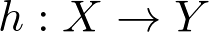
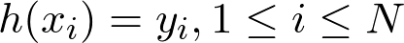
Given document-summary pairs,
there exists a summarization function
where
Types of Summaries: Dimension - Single Document

Slide 13
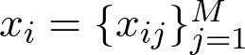
Given multidocument-summary pairs,
with each multidocument a collection of documents
there exists a summarization function
where
Types of Summaries: Dimension - Multi Document

Slide 14
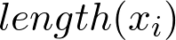
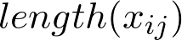
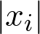
Single Document
Multi Document
Types of Summaries: Input Length

Slide 15
Single Document
Multi Document
NA
Documents can be loosely related or tightly related
Types of Summaries: Input Relation

Slide 16
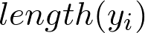
Single Document
Multi Document
Types of Summaries: Output Length

Slide 17
Single Document
Multi Document
Summarization function: generic
where
Summarization function: focused
where
Types of Summaries: Focus

Slide 18


Extractive
Abstractive
Types of Summaries: Method
Image Credits:
https://www.flaticon.com/authors/freepik
https://www.flaticon.com/authors/roundicons
Notes:
http://www.abigailsee.com/2017/04/16/taming-rnns-for-better-summarization.html
https://www.flaticon.com/authors/freepik
https://www.flaticon.com/authors/roundicons

Slide 19
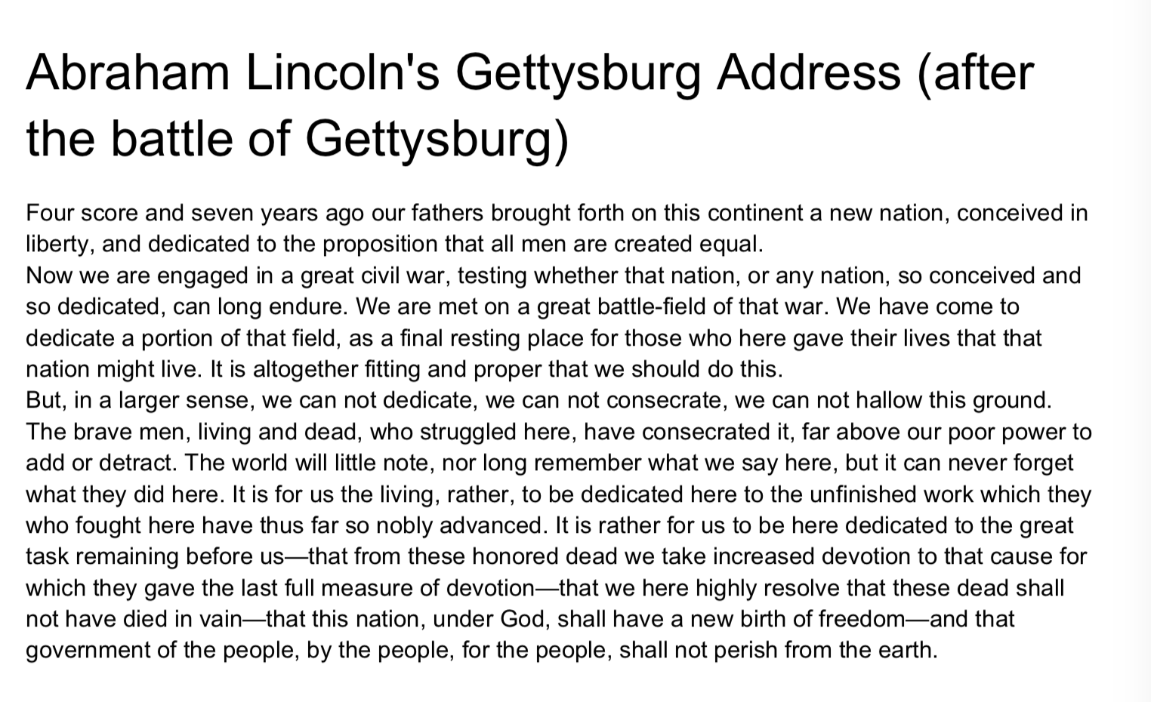
Types of Summaries: Method
Notes:
http://www.abigailsee.com/2017/04/16/taming-rnns-for-better-summarization.html
https://www.flaticon.com/authors/freepik
https://www.flaticon.com/authors/roundicons
https://www.systems.ethz.ch/sites/default/files/file/Spring2013_Courses/Intr_Nat_Lg_Pro_Spring2013/Lecture%2011%20(1).pdf

Slide 20
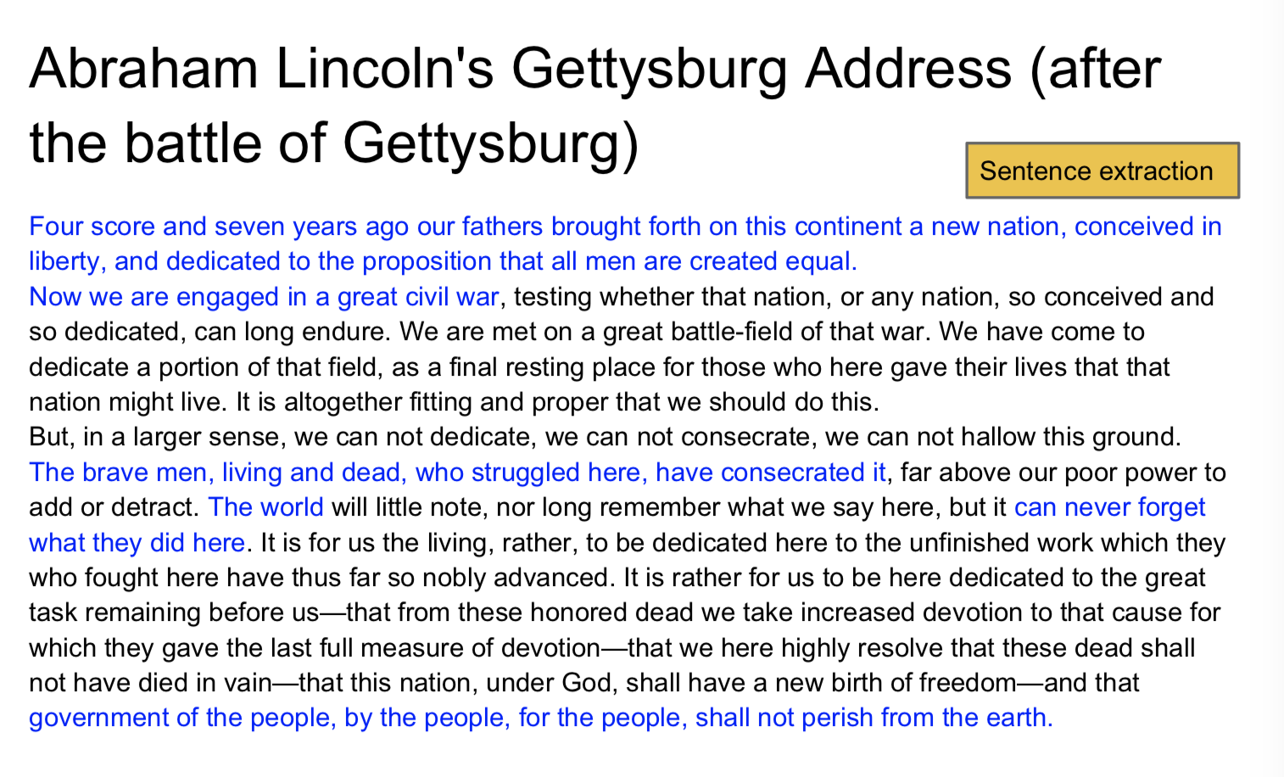
Types of Summaries: Method
Notes:
http://www.abigailsee.com/2017/04/16/taming-rnns-for-better-summarization.html
https://www.flaticon.com/authors/freepik
https://www.flaticon.com/authors/roundicons
https://www.systems.ethz.ch/sites/default/files/file/Spring2013_Courses/Intr_Nat_Lg_Pro_Spring2013/Lecture%2011%20(1).pdf

Slide 21
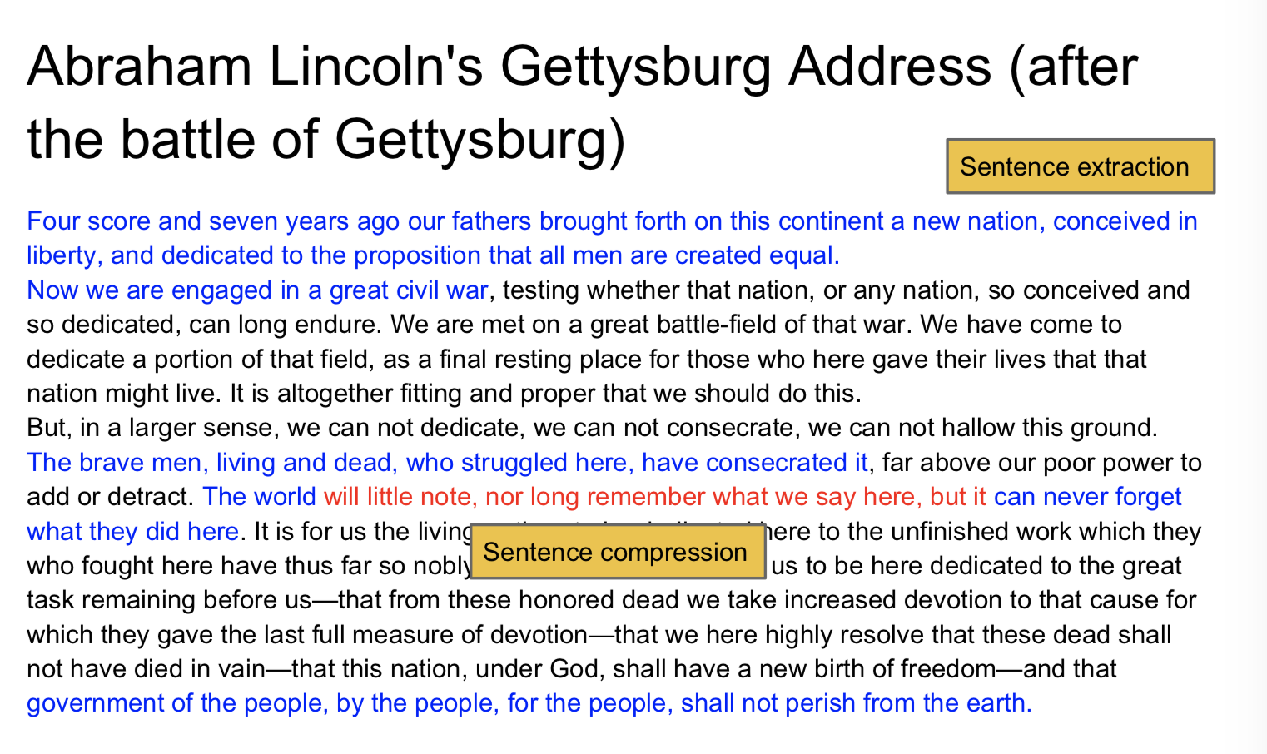
Types of Summaries: Method
Notes:
http://www.abigailsee.com/2017/04/16/taming-rnns-for-better-summarization.html
https://www.flaticon.com/authors/freepik
https://www.flaticon.com/authors/roundicons
https://www.systems.ethz.ch/sites/default/files/file/Spring2013_Courses/Intr_Nat_Lg_Pro_Spring2013/Lecture%2011%20(1).pdf

Slide 22

Types of Summaries: Method
Notes:
http://www.abigailsee.com/2017/04/16/taming-rnns-for-better-summarization.html
https://www.flaticon.com/authors/freepik
https://www.flaticon.com/authors/roundicons
https://www.systems.ethz.ch/sites/default/files/file/Spring2013_Courses/Intr_Nat_Lg_Pro_Spring2013/Lecture%2011%20(1).pdf

Slide 23
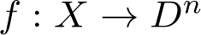
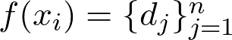
where
where
Types of Summaries: Method - Extractive
Notes:
http://www.abigailsee.com/2017/04/16/taming-rnns-for-better-summarization.html
https://www.flaticon.com/authors/freepik
https://www.flaticon.com/authors/roundicons

Slide 24
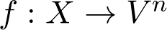
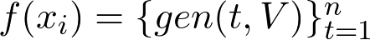
where
where
Types of Summaries: Method - Abstractive
Notes:
http://www.abigailsee.com/2017/04/16/taming-rnns-for-better-summarization.html
https://www.flaticon.com/authors/freepik
https://www.flaticon.com/authors/roundicons

Slide 25
Extractive
Abstractive
Easier
Grammatical
Readable
Relevant
Reasonably successful
Restrictive
Essential
More similar to how we summarize
Can cope with various input lengths
Difficult
Types of Summaries: Method
Notes:
http://www.abigailsee.com/2017/04/16/taming-rnns-for-better-summarization.html
https://www.flaticon.com/authors/freepik
https://www.flaticon.com/authors/roundicons

Slide 26
Outline
What is Summarization?
Types of Summarization
Evaluation Metrics
Classical Methods
Paper 1: Extractive
Paper 2: Abstractive
Paper 3: Extractive + Abstractive
Paper 4: Structure + Abstractive
Discussion Questions

Slide 27
[3] Evaluation Metrics

Slide 28
ROUGE: Recall-Oriented Understudy for Gisting Evaluation
ROUGE-N
ROUGE-L
ROUGE-W
ROUGE-S
ROUGE-SU
Types of ROUGE

Slide 29
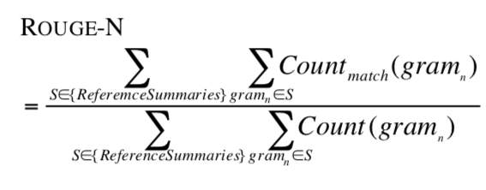
Types of ROUGE: ROUGE-N

Slide 30
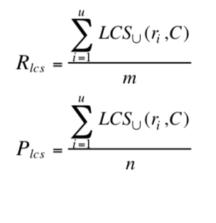
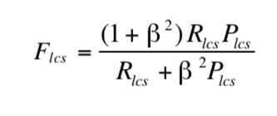
Types of ROUGE: ROUGE-L

Slide 31
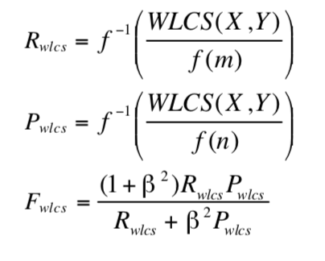
Types of ROUGE: ROUGE-W

Slide 32
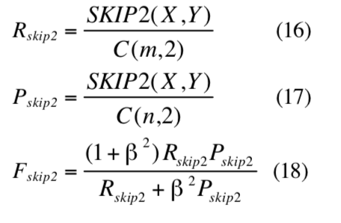
Types of ROUGE: ROUGE-S

Slide 33
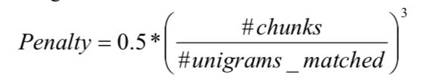
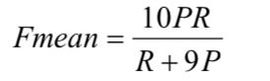
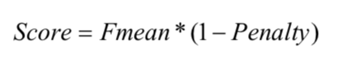
METEOR: Metric for Evaluation of Translation with Explicit Ordering
METEOR

Slide 34
Human Assessment
Relevance
Redundancy
Readability
Speed
Abstractiveness: % novel N-gram counts
Other Metrics

Slide 35
[4] Classical Methods

Slide 36
Outline
What is Summarization?
Types of Summarization
Evaluation Metrics
Classical Methods
Paper 1: Extractive
Paper 2: Abstractive
Paper 3: Extractive + Abstractive
Paper 4: Structure + Abstractive
Discussion Questions

Slide 37
MMR: Maximum Marginal Relevance
Submodularity
Graph-based: TextRank and LexRank
Classical Extractive Methods

Slide 38
[4] Classical Methods - MMR
The Use of MMR, Diversity-Based Reranking for Reordering Documents and Producing Summaries
{Carbonell, Goldstein}: CMU
SIGIR 1998

Slide 39
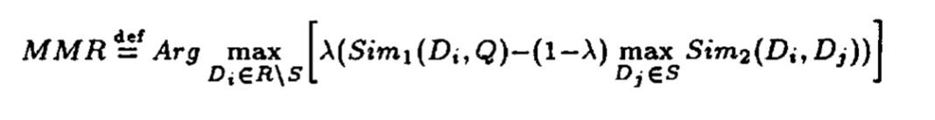
Linear combination between “relevance” and “novelty”
“Relevance”: relevant to the query, defined by Sim1
“Novelty”: minimal similarity to previously selected sentences
Classical Extractive Methods: MMR

Slide 40
Selection
Scoring
Classical Extractive Methods: MMR

Slide 41
[4] Classical Methods - Submodularity
A Class of Submodular Functions for Document Summarization
{Lin, Bilmes}: UW
ACL 2011

Slide 42
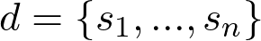
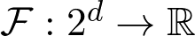
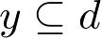
Submodularity
Given a set of sentences
and a function
for a subset
problem is
for a bound
Classical Extractive Methods: Submodular Functions

Slide 43
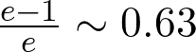
Submodularity
𝓕 is submodular if 𝓕 satisfies diminishing returns
𝓕 is monotone non-decreasing if 𝓕 satisfies
𝓕 is monotone submodular if it is both submodular and monotone non-decreasing. If 𝓕 is monotone submodular, then there is a greedy algorithm that can find an approximate solution within
of the optimal solution
Classical Extractive Methods: Submodular Functions

Slide 44
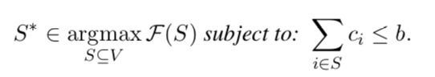
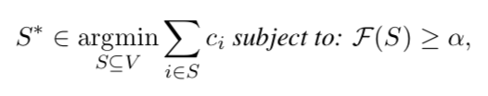
Summarization as Submodularity
Knapsack constraint
Covering constraint
Classical Extractive Methods: Submodular Functions

Slide 45
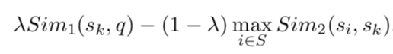
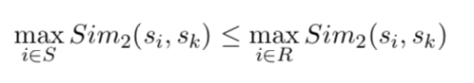
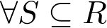
Summarization as Submodularity
MMR
is a submodular function because diminishing returns fulfills
still not monotone, so the greedy algorithm’s constant-factor approximation guarantee does not apply. We can define functions 𝓕 that are monotone submodular
Classical Extractive Methods: Submodular Functions

Slide 46
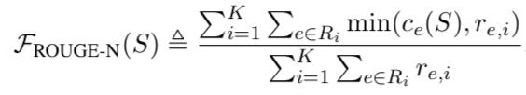
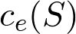
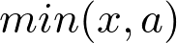
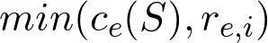
Summarization Evaluation as Submodularity
ROUGE-N
is monotone modular, and is concave non-decreasing,
is monotone submodular. Summation preserves submodularity and denominator is constant.
Therefore, ROUGE-N is monotone submodular
Classical Extractive Methods: Submodular Functions

Slide 47
[4] Classical Methods - Graph Based
TextRank: Brining Order into Texts
{Mihalcea, Tarau}: UNT
EMNLP 2004

Slide 48
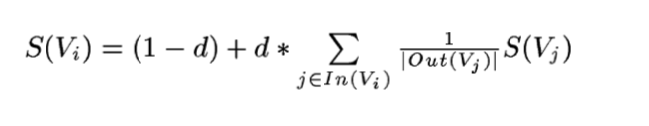
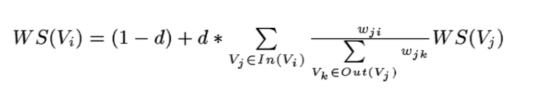
Unweighted graphs
Weighted graphs
Classical Extractive Methods: Graph-Based (TextRank)

Slide 49
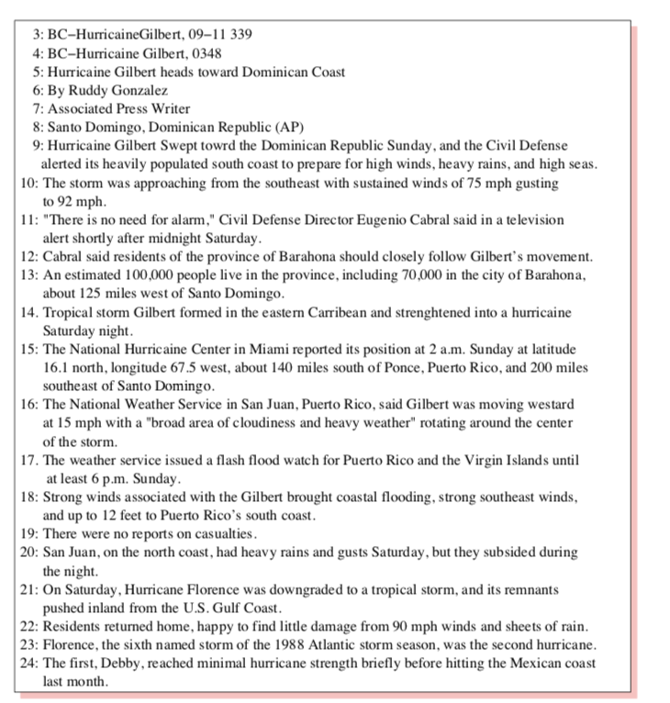
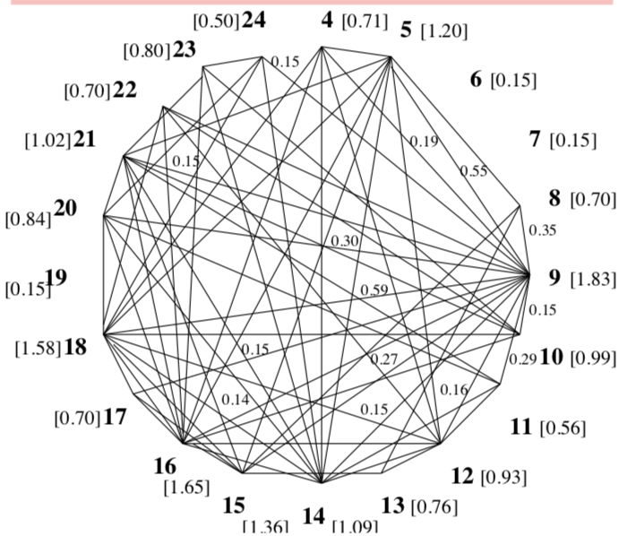
Classical Extractive Methods: Graph-Based (TextRank)

Slide 50
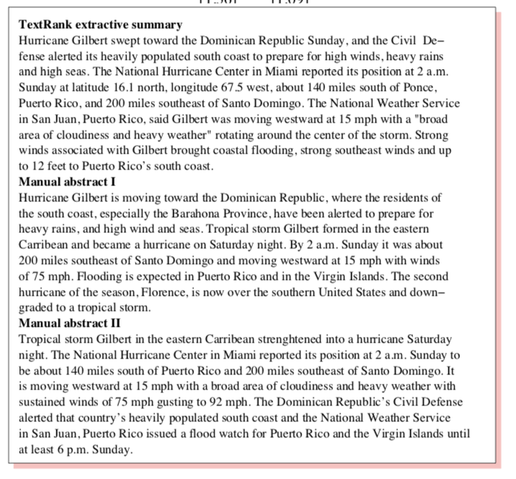
Classical Extractive Methods: Graph-Based (TextRank)

Slide 51
Outline
What is Summarization?
Types of Summarization
Evaluation Metrics
Classical Methods
Paper 1: Extractive
Paper 2: Abstractive
Paper 3: Extractive + Abstractive
Paper 4: Structure + Abstractive
Discussion Questions

Slide 52
[5] Paper 1: Extractive
Neural Document Summarization by Jointly Learning to Score and Select Sentences
{Zhou, Zhao}: HIT
{Yang, Wei, Huang, Zhou}: Microsoft Research
ACL 2018

Slide 53
A neural framework for extractive single-document summarization that conducts sentence scoring and selection simultaneously achieves (then) SOTA performance.
Hierarchical document encoder to represent sentences
Sentence extractor scores and selects a sentence from unselected sentences
Paper Summary

Slide 54
Sentence scoring:
TF, TFIDF
Sentence features
Graph-based: centrality, PageRank
Sentence Selection
MMR heuristic
Optimization problem
Recap: Extractive Methods

Slide 55
Neural Methods
Sequence labelling task
Assign probability of being extracted to each sentence
Select sentence according to probability until length limit
Recap: Extractive Methods

Slide 56
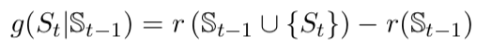
Scoring sentences requires knowledge of what has been selected
Selecting sentences requires knowledge of how sentences has been scored
Couple scoring and selection together so that
Sentence scoring is aware of previously selected sentences (use RNN)
Sentence selection is the argmax over the RNN’s learned function
Key Insight

Slide 57
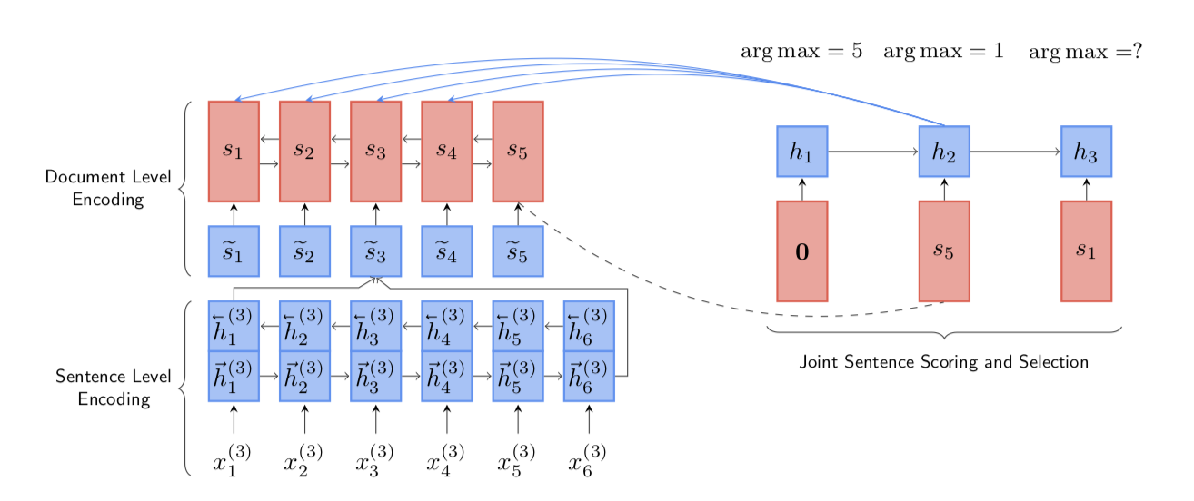
Hierarchical Document Encoder
Sentence Extractor
Pre-trained GloVe embeddings
Model

Slide 58
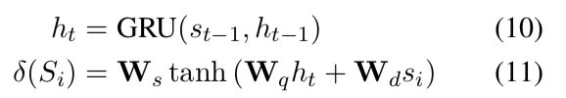
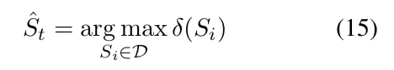
Model - Sentence Extractor

Slide 59
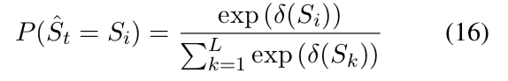
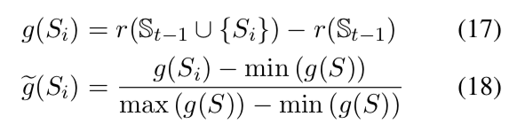
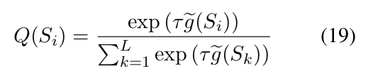
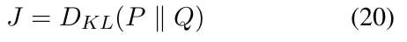
Model - Objective Function

Slide 60
CNN/Daily Mail corpus
Construct training data labels by maximizing ROUGE-2 F1 score
Use non-anonymized version
Datasets

Slide 61
munster have signed new zealand international francis saili on a two-year deal . utility back saili , who made his all blacks debut against argentina in 2013 , will move to the province later this year after the completion of his 2015 contractual commitments . the 24-year-old currently plays for auckland-based super rugby side the blues and was part of the new zealand under-20 side that won the junior world championship in italy in 2011 . saili ‘s signature is something of a coup for munster and head coach anthony foley believes he will be a great addition to their backline . francis saili has signed a two-year deal to join munster and will link up with them later this year . ‘ we are really pleased that francis has committed hi future to the province , ‘ foley told munster ‘s official website . ‘ he is a talented centre with an impressive skill-set and he possesses the physical attributes to excel in the northern hemisphere . ‘ i believe he will be a great addition to our backline and we look forward to welcoming him to munster . ‘ saili has been capped twice by new zealand and was part of the under 20 side that won the junior championship in 2011 .
utility back francis saili will join up with munster later this year . the new zealand international has signed a two-year contract . saili made his debut for the all blacks against argentina in 2013 .

Slide 62
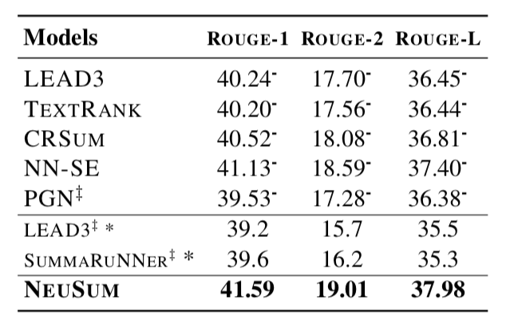

Results

Slide 63

Analysis

Slide 64
[6] Paper 2: Abstractive
Get To The Point: Summarization with Pointer-Generator Networks
{See, Manning}: Stanford
{Liu}: Google Brain
ACL 2017

Slide 65
A neural framework for abstractive single-document summarization that augments the standard sequence-to-sequence attention model with a pointer network and a coverage mechanism achieves (then) SOTA performance
Pointer-generator network allows copying words via pointing and generating words from fixed vocabulary
Coverage mechanism avoids repeated attention leading to repetitive text
Paper Summary

Slide 66

Recap: Sequence-to-Sequence with Attention

Slide 67






Recap: Sequence-to-Sequence with Attention

Slide 68
Abstractive summaries often are unable to reproduce factual details or deal with OOV words
Use a pointer network to allow copying words from source text by pointing
Abstractive summaries often repeat themselves
Use a coverage vector to keep track of attention history, and avoid repeated attention at same locations
Key Insight

Slide 69


Model - Pointer-Generator Network

Slide 70

Model - Pointer-Generator Network

Slide 71




Model - Coverage Mechanism

Slide 72

Results

Slide 73

Results

Slide 74

Analysis

Slide 75

Analysis

Slide 76
[7] Paper 3: Extractive + Abstractive
Fast Abstractive Summarization with Reinforce-Selected Sentence Rewriting
{Chen, Bansal}: UNC
ACL 2018

Slide 77
A neural framework for hybrid extractive-abstractive single-document summarization with policy gradient-based reinforcement learning achieves (then) SOTA performance
Extractor agent selects salient sentences
Abstractor network rewrites the extracted sentences
Actor-critic policy gradient reinforcement learning used to train the full model
Paper Summary

Slide 78
Extractive paradigm: directly choose and output salient sentences
+ Simpler
- Less concise
Abstractive paradigm: generate summary from scratch
+ More concise
- Slow encoding of documents
- Redundancy and repetition
Combine both extractive and abstractive paradigms into hybrid coarse-to-fine approach that is more similar to human summarization
Select salient (non-redundant) sentences, and compress them (in parallel)
Key Insight

Slide 79
where
where
Model
Notes:
http://www.abigailsee.com/2017/04/16/taming-rnns-for-better-summarization.html
https://www.flaticon.com/authors/freepik
https://www.flaticon.com/authors/roundicons

Slide 80
where
where
Model
Notes:
http://www.abigailsee.com/2017/04/16/taming-rnns-for-better-summarization.html
https://www.flaticon.com/authors/freepik
https://www.flaticon.com/authors/roundicons

Slide 81

Model - Extractor Agent

Slide 82


Model - Extractor Agent (Sentence Selection)

Slide 83
Model - Abstractor Network

Slide 84

Extractor Agent
Need proxy target label for extractor
Train to minimize cross-entropy loss
Abstractor Network
Minimize cross entropy-loss of decoder language model at each generation step
Model - Training

Slide 85


MDP at each step
Observe
Sample action
Receive reward
after summarization of extracted sentence
Model - Reinforcement Learning

Slide 86

Model - Reinforcement Learning

Slide 87
Advantage Actor-Critic
Advantage function
Actor trained to maximize advantage function with policy gradient
Critic trained to minimize square loss
Model - Reinforcement Learning

Slide 88

Results

Slide 89

Results

Slide 90


Results

Slide 91


Analysis

Slide 92
[8] Paper 4: Structure + Abstractive
Structured Neural Summarization
{Fernandes, Allamanis,
Brockschmidt}: Microsoft Research
Pending Review

Slide 93
A neural framework for abstractive single-document summarization with a sequential encoder augmented with linguistic structure (along with standard decoder) achieves performance comparable to SOTA.
Gated graph neural network takes as input the token representation of a sequence encoding as a vertex, and linguistic relations (entities, coreferences) as edges
Resulting token (node) representation used by standard decoder
Paper Summary

Slide 94

Natural Language Summarization
Method Documentation
Recap: Summarization Tasks

Slide 95
Recent work has focused on augmenting decoder, while still using a standard Sequence-to-Sequence encoder
Sequence-to-Sequence encoders still cannot truly handle arbitrarily long-distance relationships
Augment encoder with graphical structure (graph neural networks)
Key Insight

Slide 96

Model (either highlight or convert to latex?)

Slide 97

Model (either highlight or convert to latex?)

Slide 98

Model

Slide 99

Results

Slide 100

Results

Slide 101

Results

Slide 102
Discussion Questions

Slide 103
Under what circumstances might we prefer an extractive method summary to an abstractive summary? Vice versa?
What are the limitations of ROUGE and METEOR? How can we design new summarization evaluation metrics that address these limitations?
[Paper 1] Can we interpret neural extractive methods as submodular function optimization? If so, how?
[Paper 2] Abstractive methods are still not abstractive enough since they do not generate many novel n-grams. How can abstraction be enhanced?

Slide 104
[Paper 3] We have seen RL used to train a non-differentiable extractor agent. Where else is RL useful in summarization, or NLP in general?
[Paper 4] In what other scenarios does combining sequence-to-sequence methods with graphical structure make sense?

